Slide 1

Programming in python: selection
Lesson 6: Multiple elifs

Slide 2
Objectives
In this lesson, you will learn how to:
use multiple elif statements with if else to compare multiple conditions
write a program in Python that uses multiple elif statements.

Slide 3
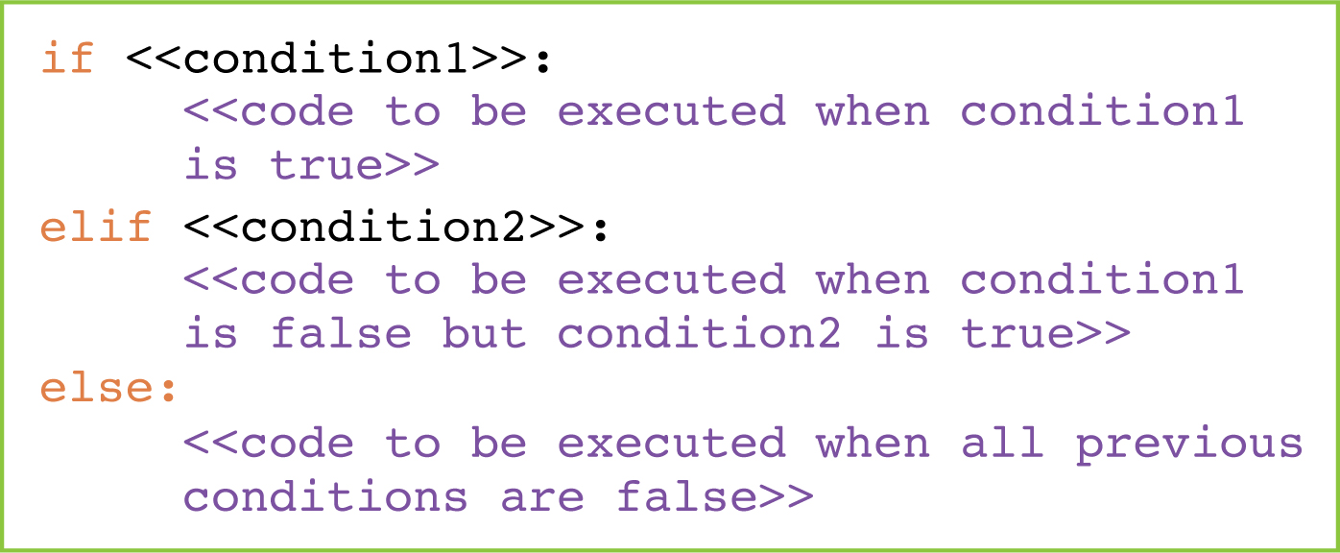
if elif else statements: a reminder
if elif else statements are used to decide what to do if the condition is true, what to do if the first condition is false and the second condition is true and what to do if both conditions are false:

Slide 4

Activity 6.1: Programming in Python: selection, Section 6

Slide 5
Question 1
Which key word do we use to check just one condition?

Slide 6
Question 2
Which key word do we use to check multiple conditions?

Slide 7
Question 3
Which operator do we use to check if something is not equal?

Slide 8
Question 4
Complete the program by filling in the gaps.
If a person is 15 or over, they are old enough to use the fairground ride.
If they are not 15 or over but are 1.5 m or taller, they are tall enough to use the fairground ride.
If they are not 15 or over and not 1.5 m or taller, they are not old enough and not tall enough to use the fairground ride.
age = ______(input('Enter age: '))
height = __________(input('Enter height: '))
if age ____ 15:
print('Old enough to ride')
________ height ________ :
print(________________________________)
__________
print('Sorry not old enough and not tall enough to ride')
int
float
>=
elif
>= 1.5
'Tall enough to ride'
else:

Slide 9
Programming constructs
There are three fundamental programming constructs:
Sequence
Selection
Iteration
In this module, all the programs you have written involved selection. They all made decisions and did something based on the outcome of those decisions.

Slide 10
Quiz 6

